Slide 1
Predicting House Prices using Machine Learning
PROBLEM DEFINITION AND DESIGN THINKING

Slide 2
Abstract
House Price Index is commonly used to estimate the changes in housing price. Since housing price is strongly correlated to other factors such as location, area, population, it requires other information apart from this to predict individual housing price. There has been a considerably large number of papers adopting traditional housing accurately, but they rarely concern about the performance of individual models and neglect the less popular yet complex models. As a result, to explore various impacts of features on prediction methods, this paper will apply both traditional and advanced machine learning approaches to investigate the difference among several advanced models. This paper will also comprehensively validate multiple techniques in model implementation on machine learning and provide an optimistic result for housing price prediction.

Slide 3
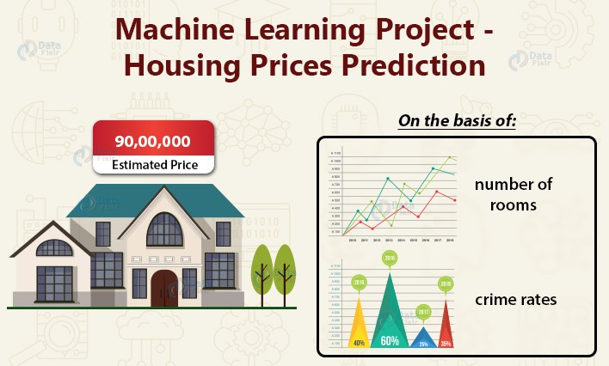
Problem Definition
The problem is to predict house prices using machine learning techniques . The objective is to develop a model that accurately predicts the prices of houses based on a set of features such as location, square footage, number of bedrooms and bathrooms and other relevant factors. This project involves data preprocessing, feature engineering, model selection, training and evaluation.

Slide 4

Design Thinking
To address this problem, we follow a systematic approach involving the following key steps:
Data Source
Data Preprocessing
Feature Selection
Model Selection
Model Training
Evaluation

Slide 5

Data Source
Choose a dataset containing information about houses, including features like location, square footage, bedrooms, bathrooms, and price.
Dataset Link: https://www.kaggle.com/datasets/vedavyasv/usa-housing

Slide 6
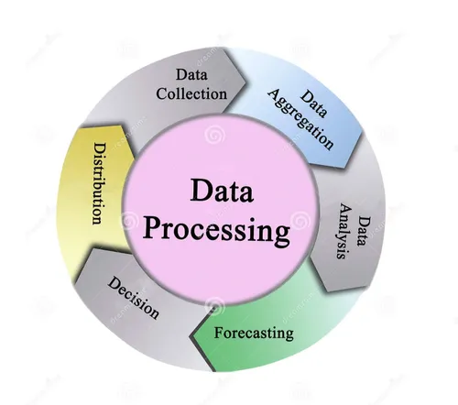
Data Preprocessing
Getting the dataset
Importing libraries
Importing datasets
Finding Missing data
Encoding categorical data
Splitting dataset into training and test set
Feature scaling

Slide 7
Feature Selection
To reduce the dimensionality of feature space.
To speed up a learning algorithm.
To improve the predictive accuracy of a classification algorithm,
To improve the comprehensibility of the learning results.
Nondeterministic approaches: genetic algorithms and simulated annealing are used in feature selection.
Select the most relevant features for predicting house price.

Slide 8
Model selection
In the project, we can develop a time series prediction technique to predict prices of the houses using historical data.
Many prediction techniques, such as random forest regressor, are widely used in the literature but the best suited one is SVM.

Slide 9
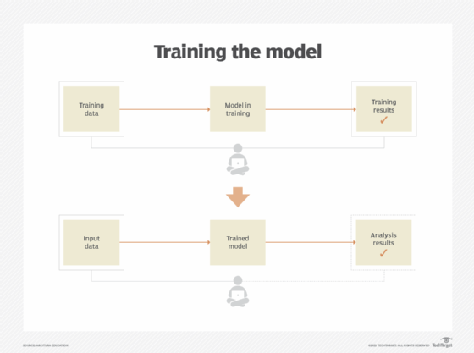
Model Training
As we have to train the model to determine the continuous values, so will be using these regression models.
SVM-Support vector machine
Random forest regressor
Linear regressor

Slide 10
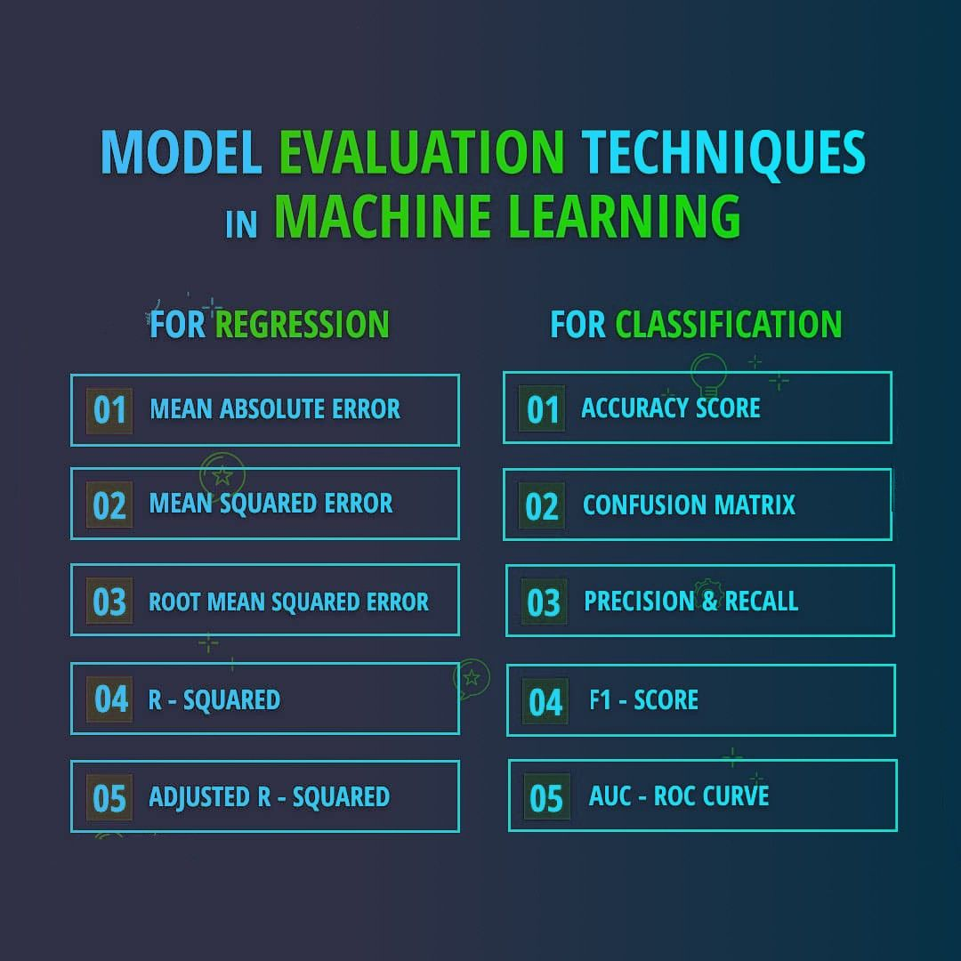
Model Evaluation

Slide 11
Conclusion
To predict the sale prices we are going to use the following linear regression algorithms: Ordinal Least Square (OLS) algorithm, Ridge regression algorithm, Lasso regression algorithm, Bayesian regression algorithm, and lastly Elastic Net regression algorithm. These algorithms can be feasibly implemented in python with the use of the scikit-learn package.
Finally, we conclude which model is best suitable for the given case by evaluating each of them using the evaluation metrics provided by the scikit-learn package.

